Slide 1


Susceptibility-weighted imaging (SWI)
Tzu-Wei (Charles) Lee

Slide 2
Susceptibility-weighted imaging (SWI)
Susceptibility-weighted imaging (SWI) is a technique, which uses tissue magnetic susceptibility differences to generate a unique contrast
Susceptibility-Weighted Imaging: Technical Aspects and Clinical Applications, Part 1
E.M. Haacke, S. Mittal, Z. Wu, J. Neelavalli and Y.-C.N. Cheng
American Journal of Neuroradiology January 2009, 30 (1) 19-30
Notes:
Concept

Slide 3
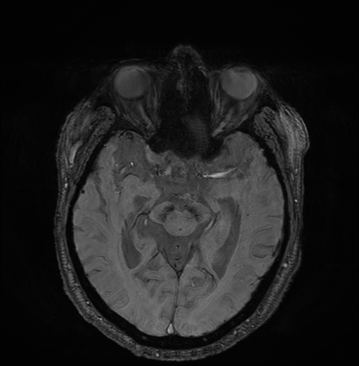
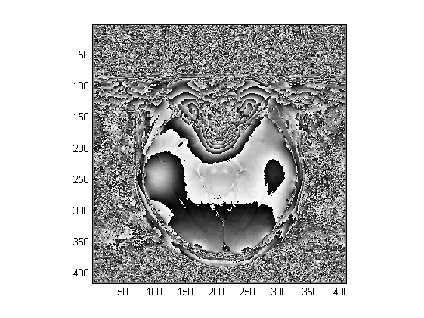
Susceptibility-weighted imaging (SWI)
Notes:
phase : spin thermal relaxation in a voxel , water motion (diffusion, perfusion, tissue deformation) , molecule electron cloud polarization
Magnitude based
Phase image as the contrast enhancement mask
Specifically, the phase images themselves can provide excellent contrast between gray matter (GM) and white matter (WM), iron-laden tissues, venous blood vessels, and other tissues with susceptibilities that are different from the background tissue.
Also, for the first time, projection phase images are shown to demonstrate tissue (vessel) continuity. In this work, the best approach for combining
magnitude and phase images is discussed

Slide 4
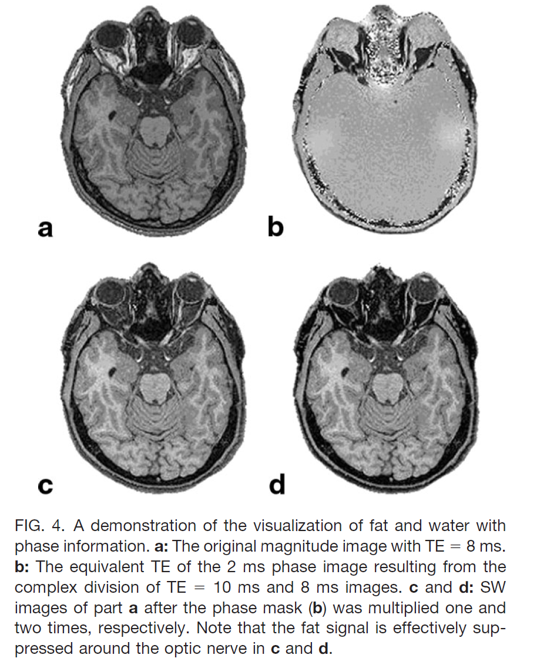
SWI Advantage
magnitude
phase
Optic nerve well shown
Fat signal saturation simplify
GM & WM more clearly
SWI
SWI(*2)
Susceptibility-Weighted Imaging; Magn Reson Med. 2004 Sep;52(3):612-8.; Haacke EM¹, Xu Y, Cheng YC, Reichenbach JR.
Notes:
One is about optic nerve observation as comparing A & D
Seccond, is about fat saturation that we could fat sat easier on SWI
Thrid one, is SWI can have the greater contrast on GM & WM

Slide 5
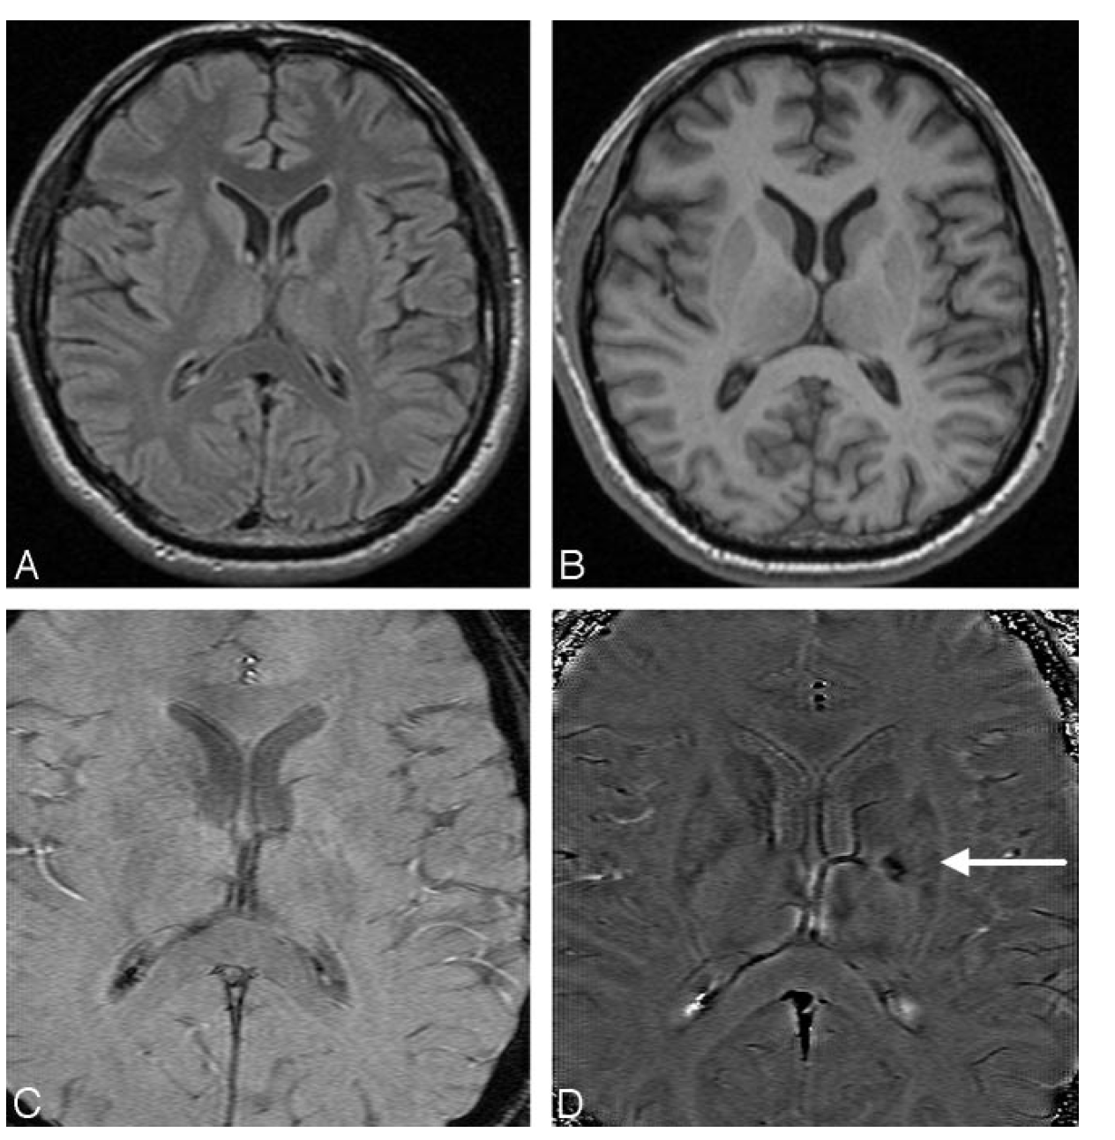
SWI Application
A: FLAIR
B: T1-weighted Image
C: TE=40 magenitude Image
D: SWI phase Image
A patient who had sudden onset of aphasia and right paresthesias 5 years earlier and who partially recovered neurologic function after treatment of the acute stroke
hemorrhage
Susceptibility-Weighted Imaging: Technical Aspects and Clinical Applications, Part 2
S. Mittal,Z. Wu,J. Neelavalli, E.M. Haacke
Notes:
Clinical Application
To date, SWI has had most of its clinical applications in the neuroimaging arena
veins
Hemorrhage
Including imaging cartilage, imaging calcium in atherosclerosis, imaging breast, and liver hemochromatosis.

Slide 6
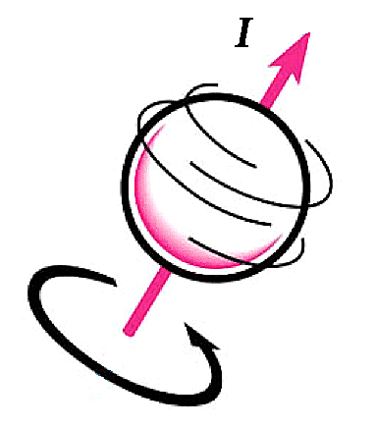
Susceptibility
Observing susceptibility inhomogeneous
From >> magnetic field inhomogeneous
by viewing as B0 map
From >> processing different (susceptibility)
by determine by particle property
http://mriquestions.com/what-is-spin.html
Notes:
Briefly show the principle of SWI
So what is susceptibility ~ susceptibility is a particle property about the spin that affect on magnetic Field

Slide 7
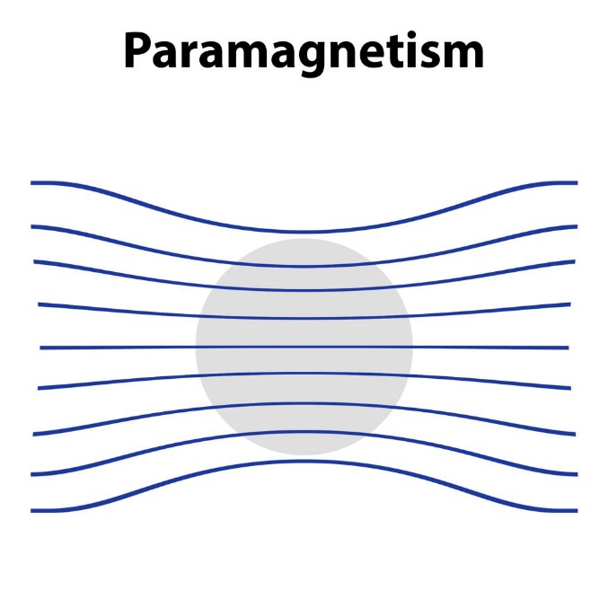
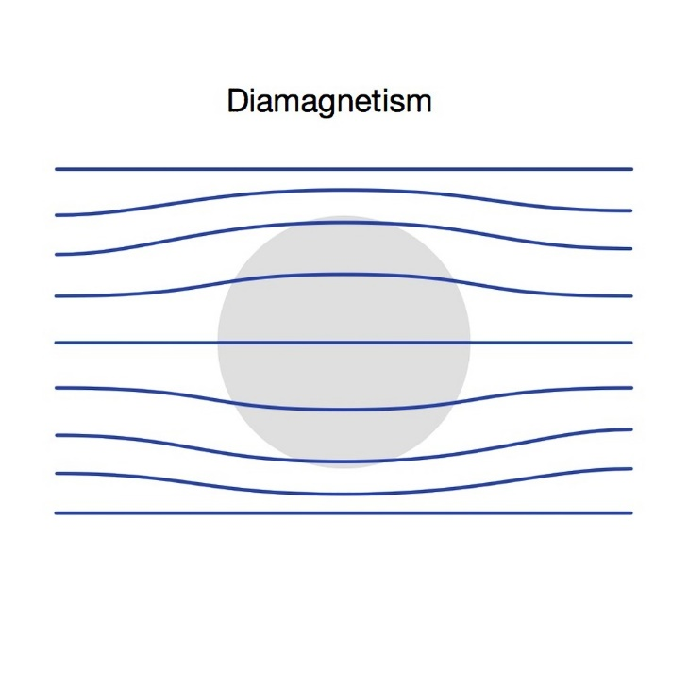
Susceptibility to Magnetic Field
Signal we acquired are from processing
Particles spins in a material orient in the same direction as the magnetic field is called paramagnetism
Particles oppose the applied field; this is called diamagnetism
Paramagnetism
Dimagnetism
https://mri-q.com/causes-of-susceptibility.html
https://radiopaedia.org/articles/paramagnetism
Notes:
Different matter will create Different magnetism one is para and another is dia

Slide 8
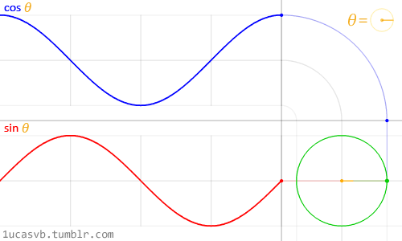
Spin to data
Two channels receive two signals
Total
Quadrature(Q) = “imaginary” part
In phase (I) = “real” part
https://betterexplained.com/wp-content/uploads/2016/12/circle-two-sine-waves.gif
http://mriquestions.com/real-v-imaginary.html
Notes:
We acquired data from two channels that we could define one is called the imaginary part
And another wiould called the real part

Slide 9
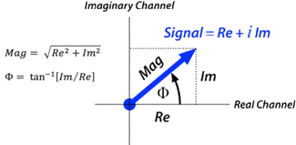
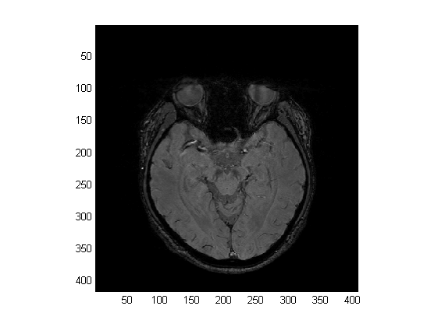
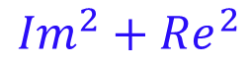
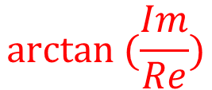
Image Data
$$arctan ⁡(\frac{Im}{Re})$$
Magnetic Image
Phase Image
$${Im}^{2}+{Re}^{2}$$
http://mriquestions.com/real-v-imaginary.html
Notes:
Polar coordinate system
phase Image is constructed from the phase from the blue vector to the real part
Phase images contain information about the background magnetic field

Slide 10
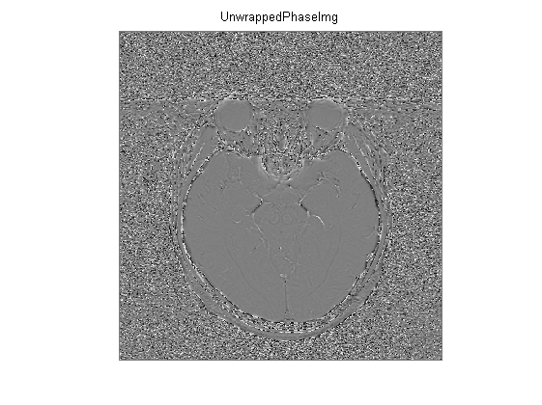
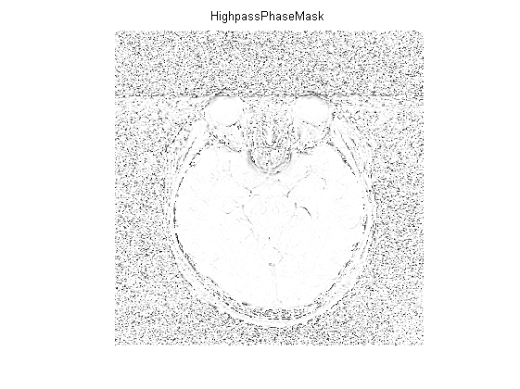
SWI process
Phase Image
High-pass filtered phase
there is high phase signal only
Phase mask
Notes:
From phase Img to create a high pass filtered phase
then make the phase mask from the high pass phase

Slide 11
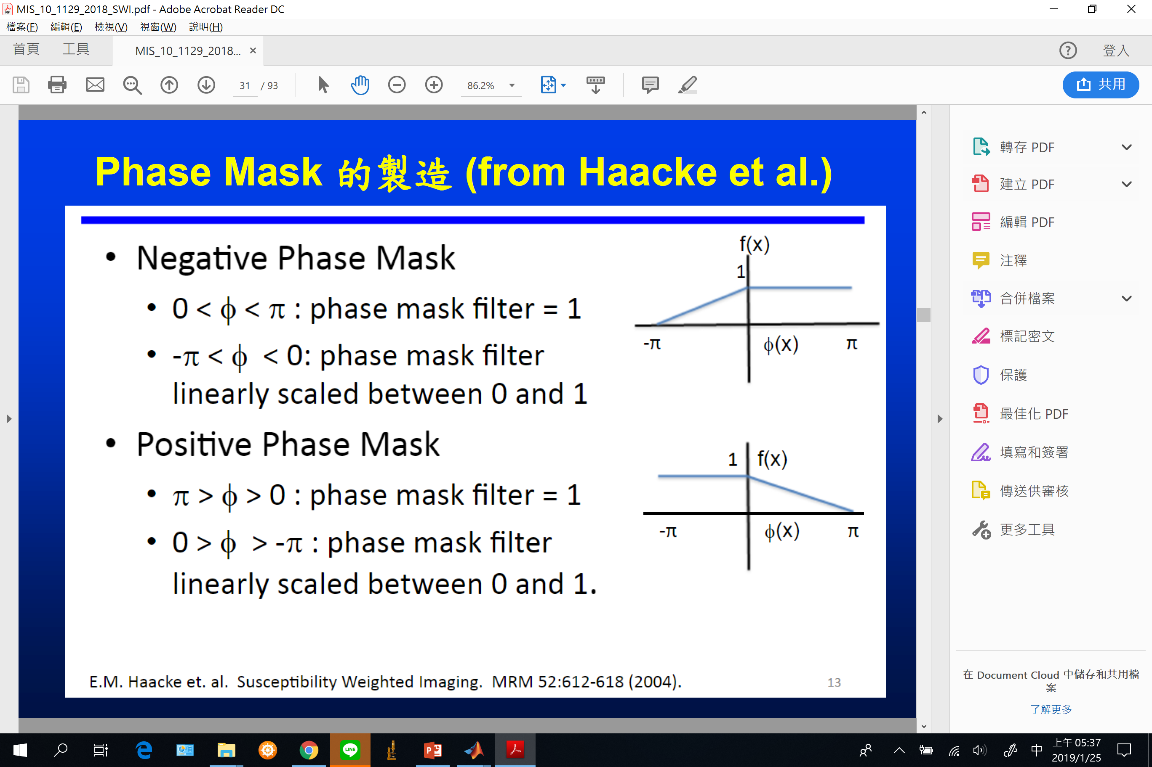
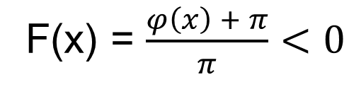
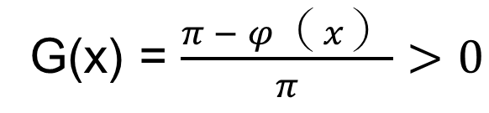
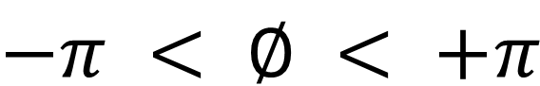
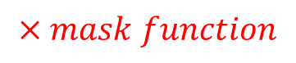
Phase Mask
High pass filter
As we know phase data is around :
$$−π < ∅ < +π$$
Negative mask
High-pass Phase
F(x) = $\frac{φ（x） + π}{π}<0$
$$×mask function$$
Positive mask
G(x) = $\frac{π − φ（x）}{π}>0$
Phase mask
Susceptibility Weighted Imaging (SWI) E. Mark Haacke,1-4* Yingbiao Xu,1,2 Yu-Chung N. Cheng,1 and Ju¨ rgen R. Reichenbach
Magnetic Resonance in Medicine 52:612– 618 (2004)
Notes:
formula
These corrected phase images were then set between zero and unity to get the phase mask.
If the contrast we wont to enhance is between from negative pi to zero , then we could apply the upper formula, on the other hand
If the contrast we wont to
Reduce
lower

Slide 12
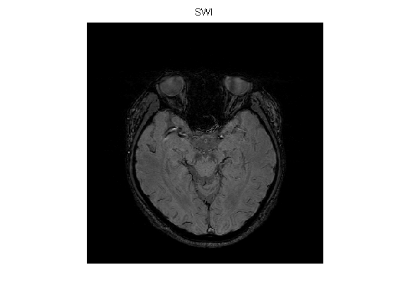
SWI process
^5
Magnitude Image
Phase mask
SWI
Notes:
A three-dimensional multiple-gradient-echo (MGE) imaging sequence was implemented.
The corrected phase images were set between zero and unity to get the phase mask (2).
The magnitude images were multiplied with the phase masks five times to enhance the visibility of the venous structures (2).

Slide 13
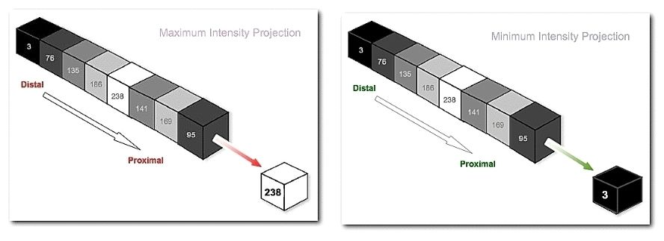
SWI tech combine
Use mIP (Minimum Intensity Projection) to enhance veins and hemorrhage
https://en.wikibooks.org/wiki/Basic_Physics_of_Nuclear_Medicine/Three-Dimensional_Visualization_Techniques#/media/File:IntProjs3.jpg
Notes:
To visual vessel & hemorrhage in a volume
We use mIP as a contrast enhance tech
mIP is finding the manimum of different slice to create a new Image that has a lot information of different slice darkest matter
maybe vessel or hemorrhage or something elses

Slide 14
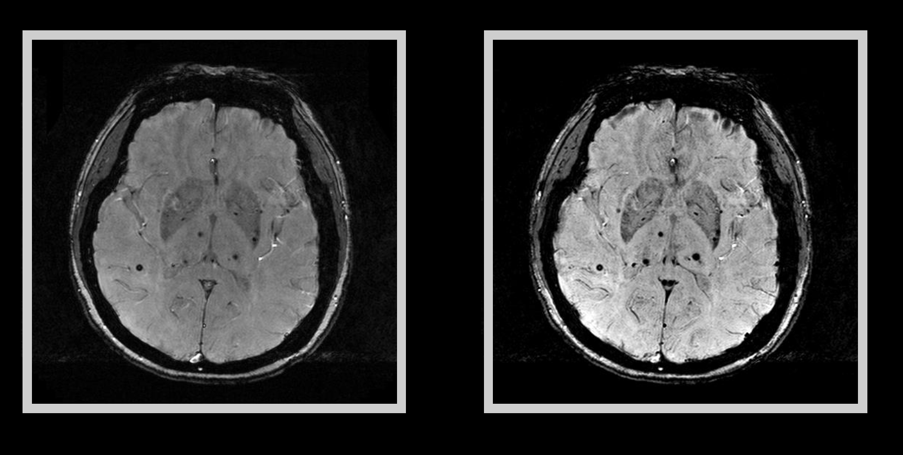
SWI mIP
Mag
SWI
+
mIP*1

Slide 15

SWI mIP
Mag
SWI
+
mIP*2

Slide 16

SWI mIP
Mag
SWI
+
mIP*3

Slide 17

SWI mIP
Mag
SWI
+
mIP*4

Slide 18

SWI mIP
Mag
SWI
+
mIP*5

Slide 19
Matlab code

Slide 20
A new SWI (combined SWI and SWAN) technique in visualizing nigrosome 1 of the substantia nigra
My Project
Tzu-Wei (Charles) Lee
Notes:
I suggest that Multi-echo-gradient-echo pulse sequence is a technique that better than the conventional single pulse one.
And focus on single specific clinic sign and

Slide 21
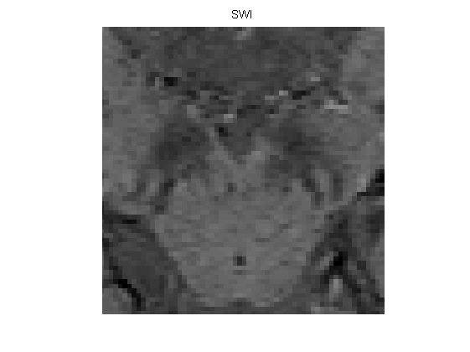
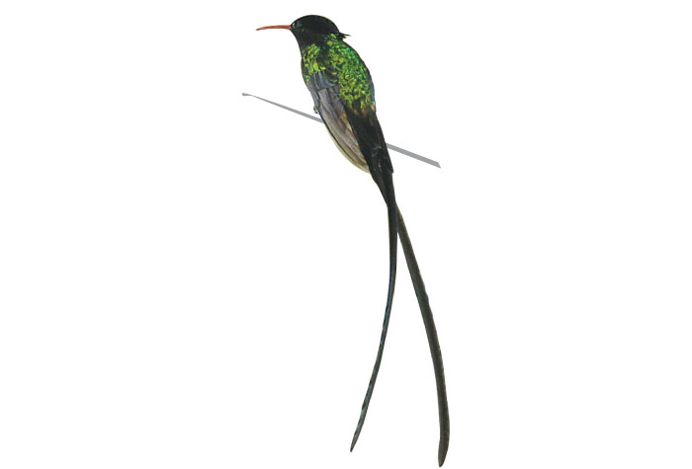
Swallow Tail in Parkinson’s Disease
Swallow tail
Substantia nigra
Nigrosome1 (melanin)
Normal people show swallow sign
Parkinson’s Disease patient show no swallow sign
https://jis.gov.jm/information/symbols/jamaican-national-bird-the-doctor-bird/
Notes:
Section of midbrain where a portion of the substantia nigra is visible
Swallowtail appearance is a new or not that new and easy applicable MRI diagnostic tool for nigral degeneration in PD

Slide 22
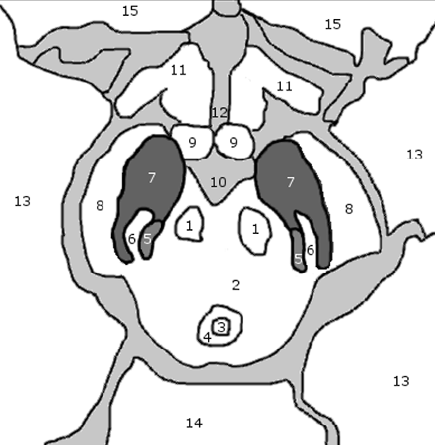
Swallow Tail Sign
1 red nucleus
2 midbrain tegmentum
3 aqueduct
4 periaqueductalgrey
5 medial leminiscus
6 nigrosome-1
7 substantia nigra
8 cerebral peduncle
9 mammillary body
10 inter-peduncular fossa
11 optic radiation
12 3rd ventricle
13 temporal lobe
14 cerebellum
15 frontal lobe.
The ‘Swallow Tail’ Appearance of the Healthy Nigrosome– A New Accurate Test of Parkinson’s Disease: A Case- Control and Retrospective Cross-Sectional MRI Study at 3T
Stefan T. Schwarz1*, Mohammed Afzal2, Paul S. Morgan3, Nin Bajaj4, Penny A. Gowland5,
Dorothee P. Auer1
Notes:
Anatomy

Slide 23
Swallow Tail in Parkinson’s Disease
Healthy Subject
PD Patient
3T Siemens PRISMA
Notes:
Section of midbrain where a portion of the substantia nigra is visible

Slide 24
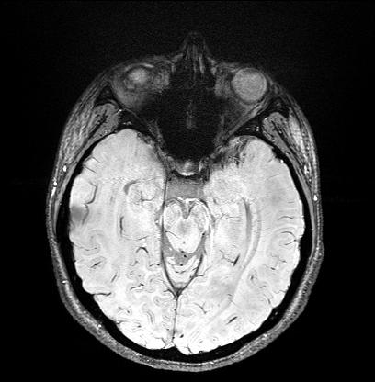
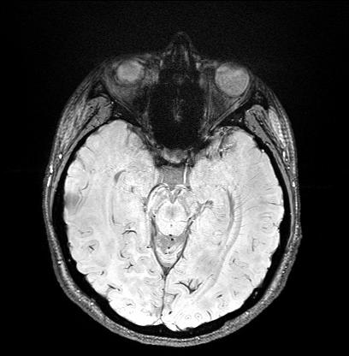
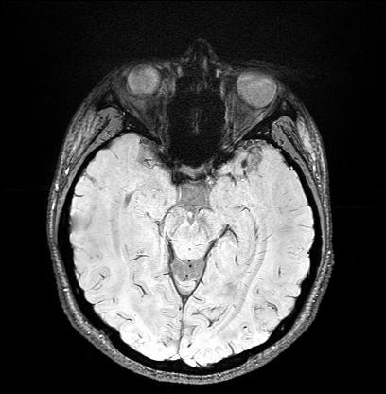
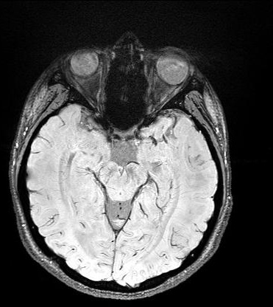
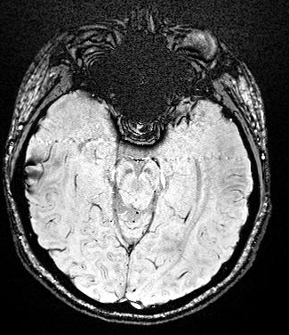
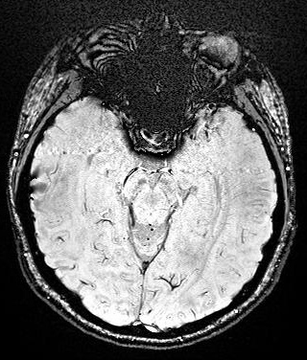
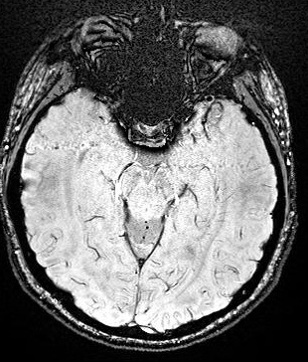
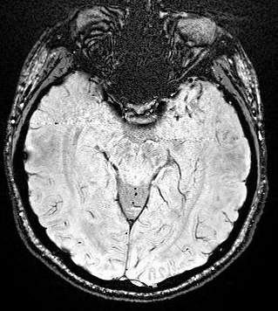
Subject 01
New Tech
Routine SWI
Notes:
sinuses

Slide 25
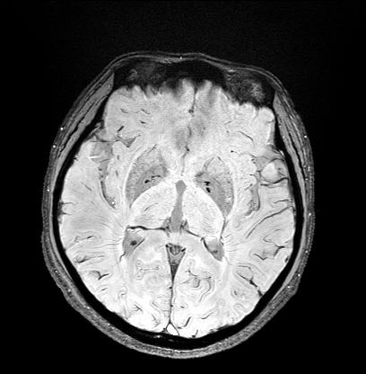
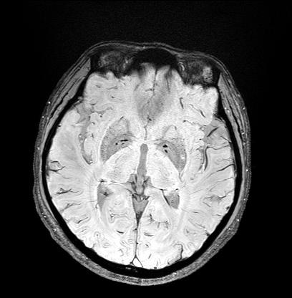
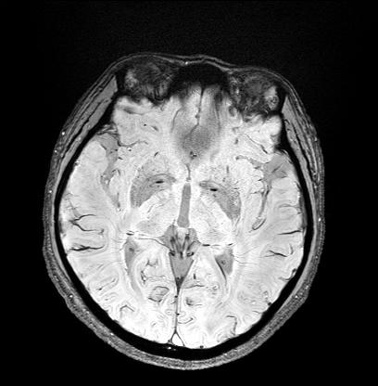
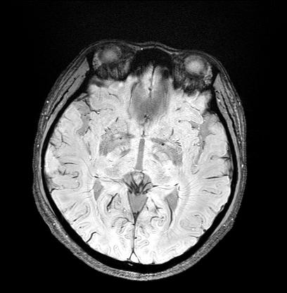
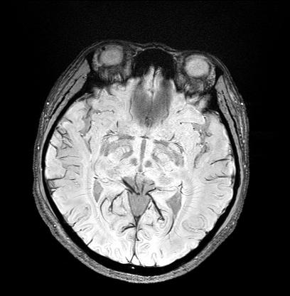
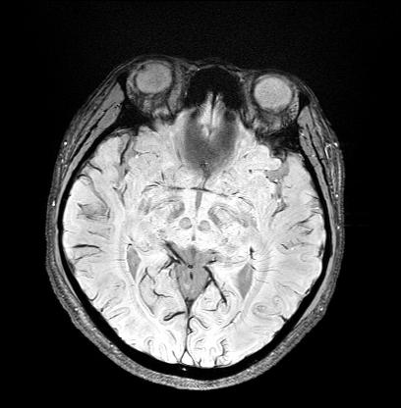
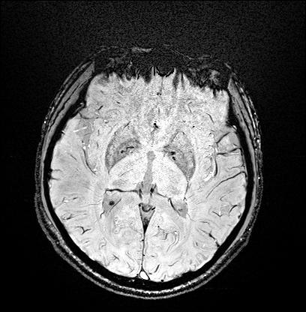
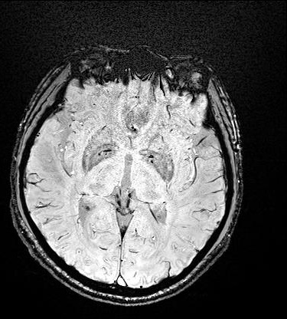
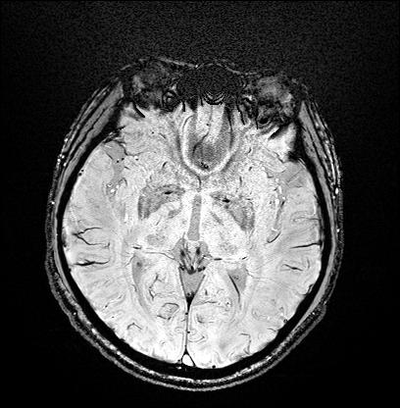
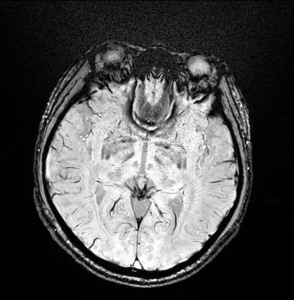
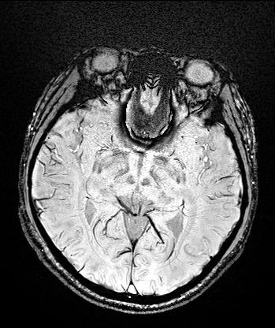
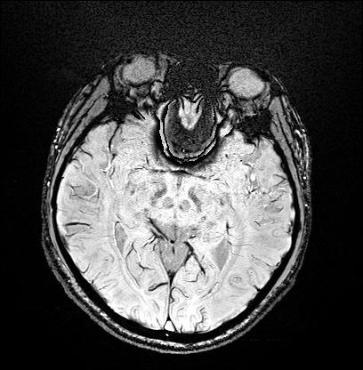
Subject 01
New Tech
Routine SWI

Slide 26
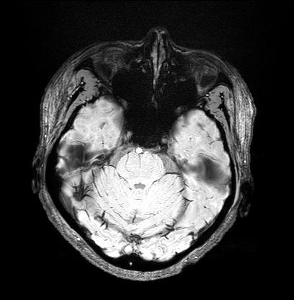
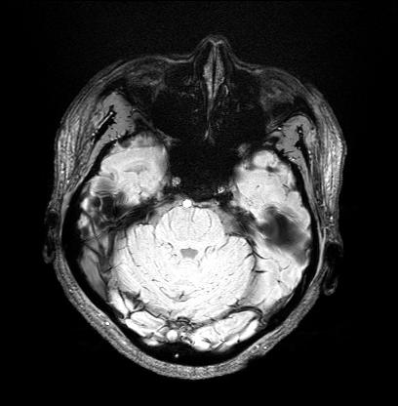
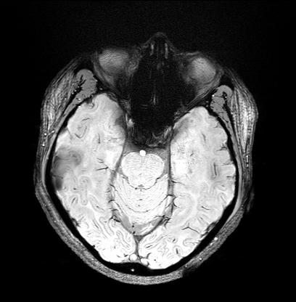
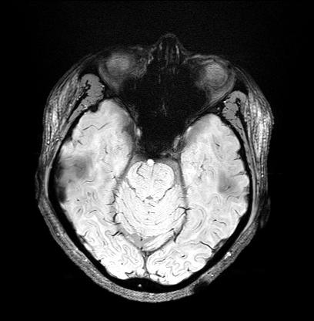
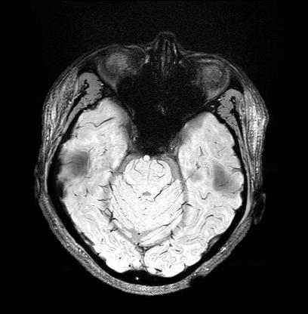







Subject 01
New Tech
Routine SWI
Notes:
你看frontal sinus和耳洞的susceptibility artifact用新的技術都補回來了
Cochlea

Slide 27






Subject 02
New Tech
Routine SWI

Slide 28












Subject 02
New Tech
Routine SWI

Slide 29












Subject 02
New Tech
Routine SWI

Slide 30

Result – Swallow Tail sign
Notes:
section of midbrain where a portion of the substantia nigra is visible
The recent advance in MR imaging has shown the potential role of susceptibility-weighted imaging (SWI) in visualizing the nigrosome1, which is a known marker for Parkinson disease(1).
Multi-echo-gradient-echo pulse sequence is a technique which can provide the higher image quality by the weighted sum of the images from different echo times and the quantitative measures of susceptibility using phase information. In this work, we used a hybrid technique by combing magnitude and phase images from different echo times to assess its potential in the depiction of the nigrosome1.
The new hybrid technique of susceptibility-weighted imaging (SWI_{new}) combined magnitude and the filtered phase images from different echo times.
The contrast-to-noise ratio (CNR) was calculated focusing on the ratio of signal intensity from the nigrosome1 to its surrounding area in the substantia nigra.
We compared the CNR between the new hybrid technique and the conventional SWI and T2* map in 22 normal subjects.

Slide 31




Swallow Tail sign Boundary
Fuzzy cluster mean (FCM)
To segment the Nigrosome1 & Substantia nigra
$$J= \sum_{j=0}^{k}{\sum_{i=0}^{n}{{{(u}_{ij})}^{m}{{(s)}^{2}}_{ij}}}$$
Distance
$x^{2}$+$y^{2}$
Find minimum
Signal intensity
$0≤u≤$1
Notes:
Section of midbrain where a portion of the substantia nigra is visible
cluster analysis

Slide 32



Contrast to Noise Ratio(CNR)
CNR
To quantify the signal from swallowtail sign
$$\frac{S_{1}−S_{2}}{σ_{0}}$$
$$S=signal intensity 1 \& 2$$
$$σ=standard deviation$$
Sum Signal intensity of Substantia nigra
Sum Signal intensity of Nigrosome1
Notes:
Section of midbrain where a portion of the substantia nigra is visible
Statistics
Matlab

Slide 33

Results – CNRs
Technique | mean
Left_CNR_swi_new | 28.27$±$10.26%
Right_CNR_swi_new | 25.67$±$8.07%
Left_CNR_SWI | 22.62$±$10.00%
Right_CNR_SWI | 20.50$±\text{7.20}$%
Left_T2* | 41.76$±$ 14.99%
Right_T2* | 37.09$±\text{14.38}$%
Notes:
Section of midbrain where a portion of the substantia nigra is visible

Slide 34

Conclusion
The enhanced nigrosome1 in the T2* map might be attributed to its long T2 value
Notes:
Nigrosome1 melanin

Slide 35
Future Work
Quantitative Susceptibility Mapping (QSM)
Questions or Suggestions
Notes:
Section of midbrain where a portion of the substantia nigra is visible

Slide 36
supplement

Slide 37
Spin to data
Total
Im
Re
https://betterexplained.com/wp-content/uploads/2016/12/circle-two-sine-waves.gif
http://mriquestions.com/real-v-imaginary.html

Slide 38






High Pass Filter Image
K-space
$$arctan ⁡(\frac{Im}{Re})$$
$$×fft$$
Phase Image
Fill in zeros of low freq
$$×fft$$
None wrapped Phase
(high-pass filtered phase)
$$arctan ⁡(\frac{Im}{Re})$$

Slide 39

Multiplication of Mask making
To acquire best contrast, how many times should we multiply?
CNR & SNR trade off
Susceptibility-Weighted Imaging; Magn Reson Med. 2004 Sep;52(3):612-8.; Haacke EM¹, Xu Y, Cheng YC, Reichenbach JR.
Notes:
Line Graph
The more we multiply the better contrast we get
It is a trade off of CNR ( contrast 2 noise ratio ) & SNR ( signal 2 noise ratio )
The more we multiply, the contrast we get is better, but the SNR is increasing at the same time

Slide 40

Image compare
Mag+phase
(unprocessed)
SWI
(full-processed)
HP phase
Susceptibility-Weighted Imaging: Technical Aspects and Clinical Applications, Part 1; E.M. Haacke, S. Mittal, Z. Wu, J. Neelavalli, Y.-C.N. Cheng
Notes:
Maybe we can see the contrast from the image of the process
Why not just highpass Image or SWI mitiply phase mask*1

Slide 41

SWI mIP
Susceptibility-Weighted Imaging: Technical Aspects and Clinical Applications, Part 1; E.M. Haacke, S. Mittal, Z. Wu, J. Neelavalli, Y.-C.N. Cheng

Slide 42

Vessels & Hemorrhage Contrast
mIP magnitude
mIP SWI
mIP phase
Susceptibility-Weighted Imaging; Magn Reson Med. 2004 Sep;52(3):612-8.; Haacke EM¹, Xu Y, Cheng YC, Reichenbach JR.
Notes:
出血
hemorrhage

